Slide 1


Inclusive Communication
with Karen Watson

Slide 2





Introduction

Slide 3
What will we cover today?
What does inclusive communication mean?
What communication needs might our learners have?
Verbal skills and anxiety
What types of visual can I use?
Why should I use visuals?
Where to start using visuals in the classroom
Top tips for using visuals
When to stop using visuals
Q+A

Slide 4
What does inclusive communication mean?
Remember to teach all children alternative communication methods, not just the child who needs it. Otherwise who will they communicate with?
Visual Teaching Alliance stats
-90% of information transmitted to the brain is visual
-visual information is processed 60,000 times faster that text

Slide 5
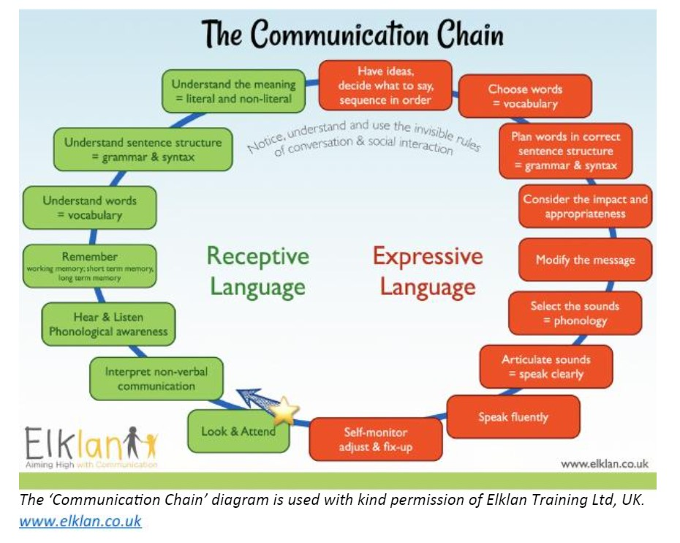
What communication needs might our learners have?
Pre verbal
Require additional
processing time
Input or output needs

Slide 6

Verbal skills and anxiety
As anxiety levels increase, verbals skills may decrease

Slide 7
What types of visual can I use?
concrete
easiest
Objects of reference
Photos
Coloured symbols
Black and white symbols
Text
abstract
hardest

Slide 8
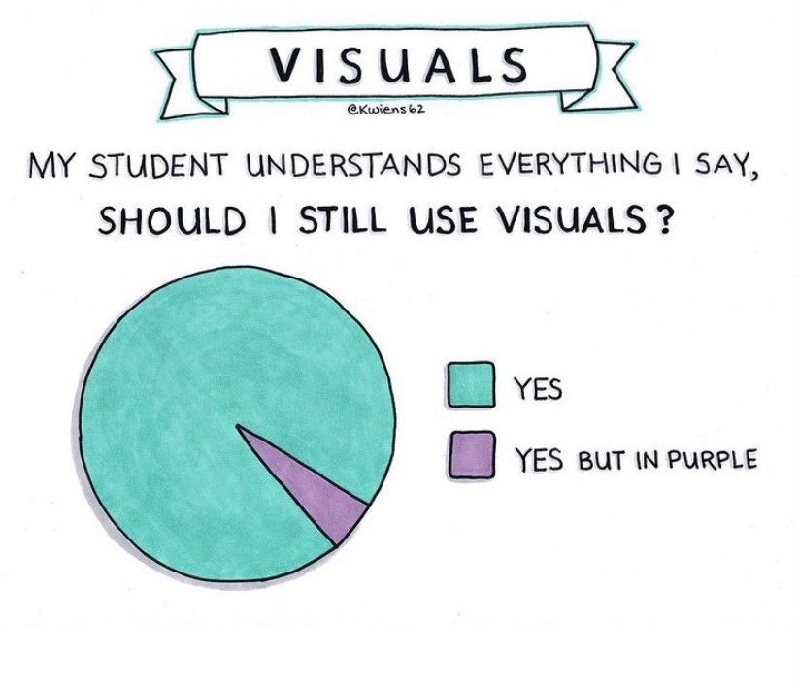
Why should I use visuals

Slide 9

Why should I use visuals
Visuals help all children
Visuals are permanent and predictable
Visuals allow processing time
Visuals allow high information retention
Visuals give clear expectations
Visuals support routine and transitions
Visuals support comprehension
Visuals build independence
Visuals are transferable between people and
settings
Visuals have no emotions

Slide 10
Where to start using visuals in the classroom
Timetables
Display
Personal documents
Environmental labelling
Core language boards

Slide 11
Top tips for using visuals
Use written words, verbals words and signing to augment visuals
Don’t rush through the stages, it isn’t a race and there is no ‘end goal’
Use them consistently

Slide 12

When to stop using visuals
Never…

Slide 13


Slide 14
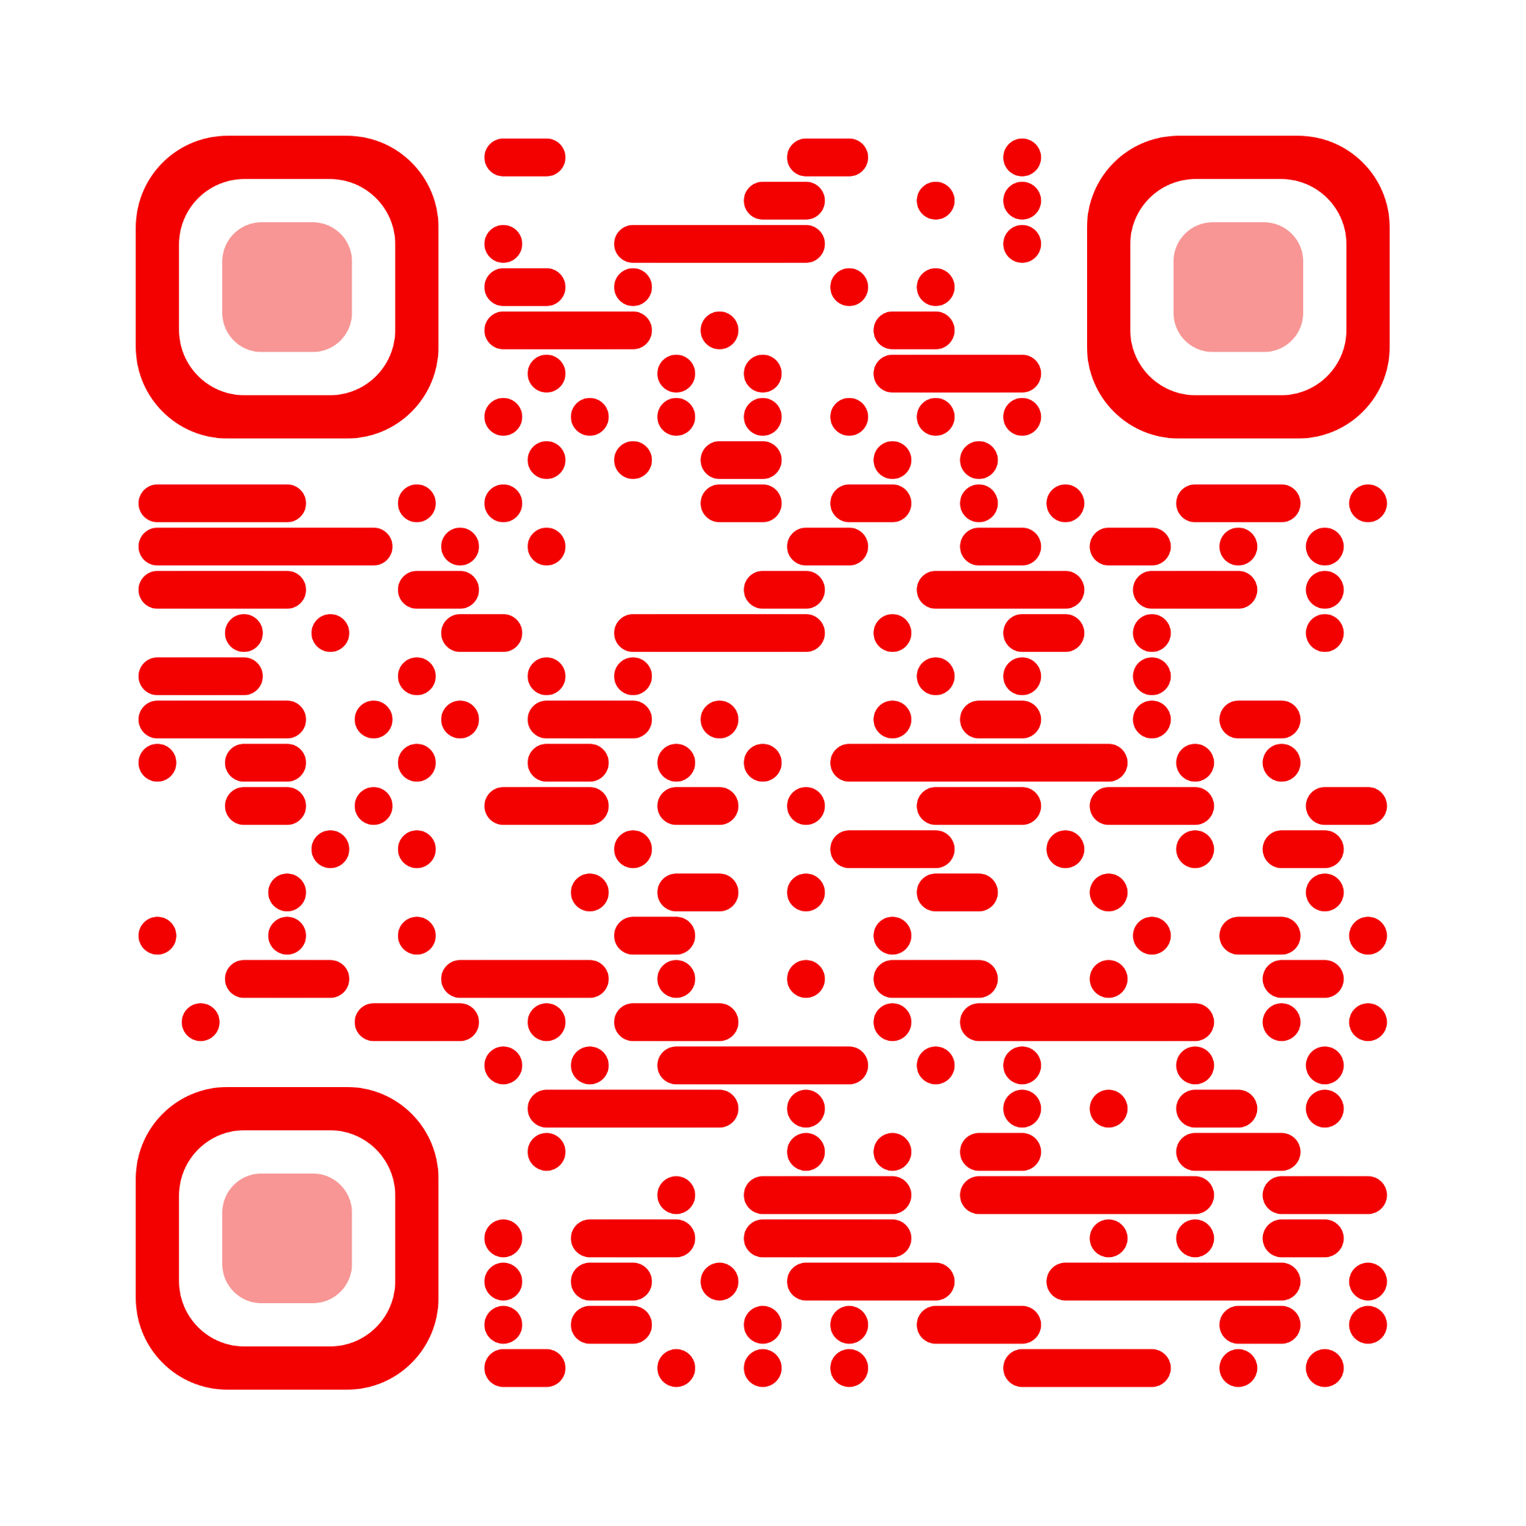
Any questions?
Contact me
Instagram @Scottish_ASN_Teacher
Twitter @Karen_N_Watson
www.scottishasnteacher.com
Email scottishasnteacher@gmail.com

